Slide 1



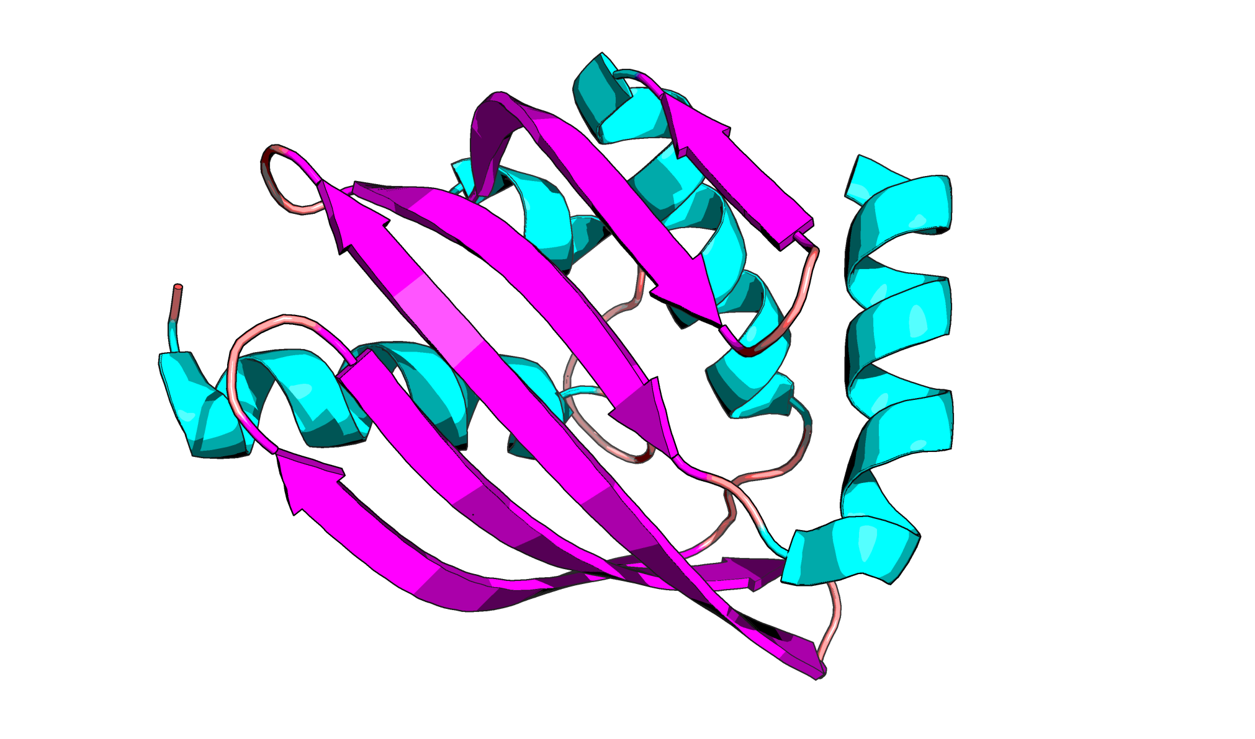
Improved Generation of Symmetric Cyclic Peptide Complexes
John Chu^{1,3}, David Juergens^{2,3}, Helen Eisenach^{3,4}, Gaurav Bhardwaj^{3,5}, David Baker³
¹Department of Mathematics and Computer Science, Dickinson College. ²Molecular Engineering and Science Institute, University of Washington. ³Institute for Protein Design, University of Washington. ⁴Department of Medicine, University of Washington. ⁵Department of Pharmacy, University of Washington.
Introduction
State what you did
State how you know it works
Motif:
To make consistent images in Pymol :
color > by ss > Helix Sheet Loop
Describe the scale and detail of your validation
Objective
What is the big-picture goal of this work?
Make sure your plots are well labeled.
Appraoch
If you used an existing design method, write about it here.
Future Work
References
You can describe work that is ongoing, or the next logical step for this project. Or maybe it’s in the hands of a collaborator? State that, and what they’re doing.
Stephen Rettie Cyclic things
Gaurav’s & Sergay AF2 prediction
David J’s symmetricity paper
RFDiffusion
MPNN
John Jumper AF2 paper
Metal binding (David J shared it)

